Slide 1
C # language essentials Working with strings and numeric data

Slide 2
How to declare and initialize variables and constants

Slide 4
Description
A variable stores a value that can change as a program executes, while a constant stores a value that can't be changed. Before you can use a variable or constant, you must declare its type and assign an initial value to it.
Common initial values are 0 for variables that store integer values, 0.0 for variables that store decimal values, and false for variables that store Boolean values.
To declare or initialize more than one variable for a single data type in a single statement, use commas to separate the variable names or assignments.
To identify literal values as float values, you must type the letter F after the number.
To identify decimal values, you must type the letter m or M after the number.
The keywords for data types must be coded with all lowercase letters.

Slide 5
Naming conventions
Start the names of variables with a lowercase letter, and capitalize the first letter of each word after the first word. This is known as camel notation.
Capitalize the first letter of each word of a constant name. This is known as Pascal notation.

Slide 6
Using the math class

Slide 7
Using the Math class

Slide 9
Math class – examples

Slide 10
Using the Math Class
The Round method rounds a decimal argument to the specified precision, which is the number of significant decimal digits.
If the precision is omitted, the number is rounded to the nearest whole number. By default, if you round a decimal value that ends in 5, the number is rounded to the nearest even decimal value. This is referred to as banker's rounding.

Slide 11
Using the Math Class
The Pow method raises the first argument to the power of the second argument. Both arguments must have the double data type.
The Sqrt method returns the square root of the specified argument, which can have any numeric data type.
The Min and Max methods return the minimum and maximum of two numeric arguments. The two arguments must have the same data type.

Slide 12
Using the midpointrounding option
MidPointRounding enumeration has two values ToEven and AwayFromZero.
Default value for MidPointRounding is “ToEven”.
ToEven rounds the value to the nearest even number and
AwayFromZero rounds the value to the value which is away from zero.

Slide 13
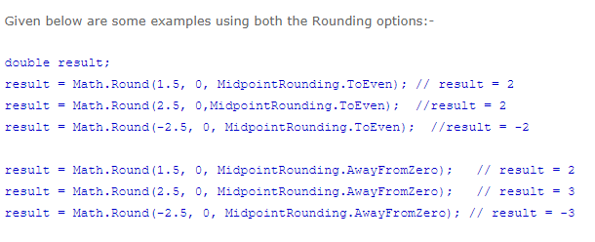

Slide 14
Working with Strings

Slide 15
Working with strings
A string can consist of any characters in the character set including letters, numbers, and special characters like $, *, &, and #.
To specify the value of a string, you can enclose text in double quotes. This is known as a string literal.
To assign a null value to a string, you can use the null keyword. This means that the value of the string is unknown.

Slide 16
Working with strings
To assign an empty string to a string, you can code a set of double quotes with nothing between them. This usually indicates that the value of the string is known, but the string doesn't contain any characters.
To join, or concatenate, a string with another string or a value data type, use a plus sign. If you concatenate a value data type to a string, C# will automatically convert the value to a string so it can be used as part of the string.

Slide 17
Working with strings

Slide 18
Working with strings

Slide 19
Working with strings
When you append one string to another, you add one string to the end of another. To do that, you can use assignment statements.
The += operator is a shortcut for appending a string expression to a string variable.

Slide 20
Working with strings

Slide 21
Include special characters in string
Within a string, you can use escape sequences to include certain types of special characters.
To code a verbatim string literal, you can code an @ sign, followed by an opening double quote, followed by the string, followed by a closing double quote.
Within the verbatim string, you can enter backslashes, tabs, new line characters, and other special characters without using escape sequences. However, to enter a double quote within a verbatim string literal, you must enter two double quotes.

Slide 22
Include special characters in string

Slide 23
Include special characters in string

Slide 24
Include special characters in string

Slide 25
How to use methods to convert data types
Like the Parse method and Convert class that converts Strings to another datatype, we can make use of methods like ToString() that converts any datatype to string and TryParse() that coverts string into an equivalent data value.

Slide 26
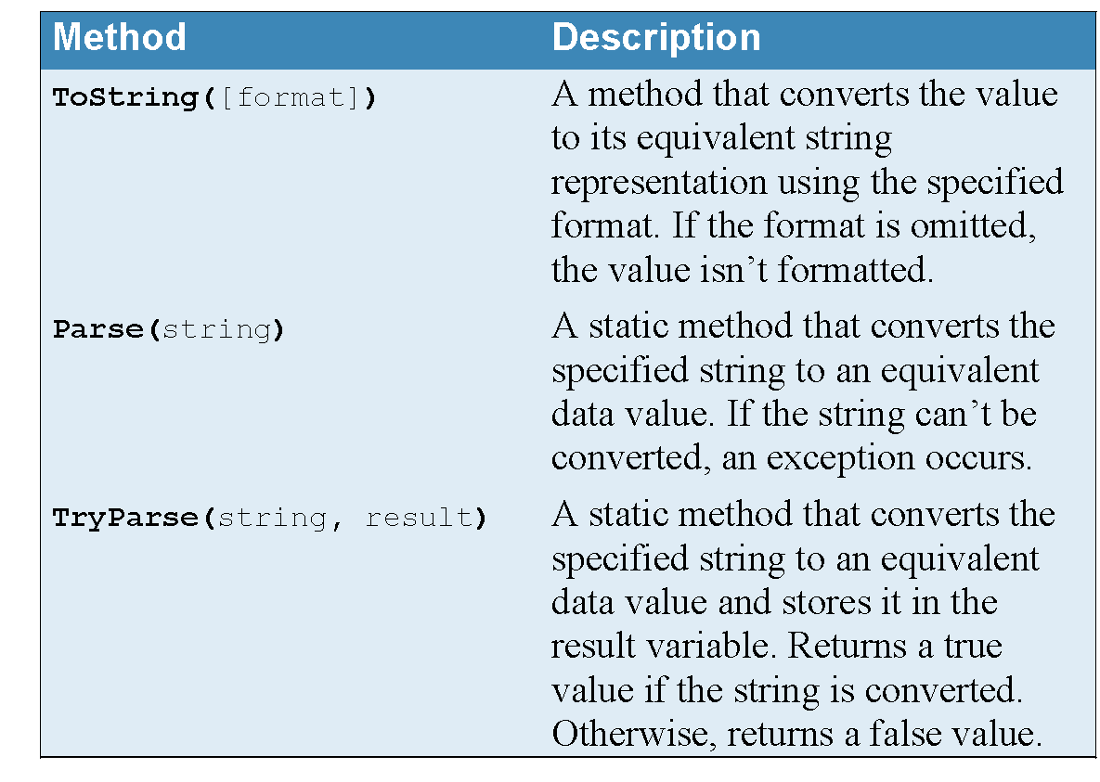
Common methods for data conversion
© 2016, Mike Murach & Associates, Inc.

Slide 27
Tostring method
C# calls the ToString method implicitly in certain situations. For example, a double value is automatically converted to a string when it's joined with another string.
The Parse method is a static method that performs the reverse operation of the ToString method. In other words, it converts a string value to another data type.
In the third statement(next slide) in the first group of statements, for example, the Parse method of the Decimal structure is used to convert the value of a string variable to a decimal value.
However, this method only recognizes standard numeric characters. As a result, an exception will occur if you try to convert a string that includes non-numeric characters.

Slide 29
How to use methods to convert data types
One way to avoid exceptions is to use the TryParse method instead of the Parse method.
This method also converts a string value to another data type as illustrated by the last statement in the first group of statements(previous slide).
Notice here that you don't assign the result of the TryParse method to a variable like you do when you use Parse.

Slide 30
Tryparse method
Instead, you name the variable on the second argument of the method, and you precede the name of the variable with the out keyword.
If the conversion is performed the second argument contains the result.
If the conversion can't be performed, the TryParse method stores a value of zero in the variable and returns a false value instead of throwing an exception. Then, you can test the return value to determine if the conversion was successful.

Slide 32
Composite formatting

Slide 33
Composite Formatting
A composite format string consists of fixed text intermixed with indexed placeholders, called format items, that correspond to the objects in the list.
The formatting operation yields a result string that consists of the original fixed text intermixed with the string representation of the objects in the list.

Slide 34
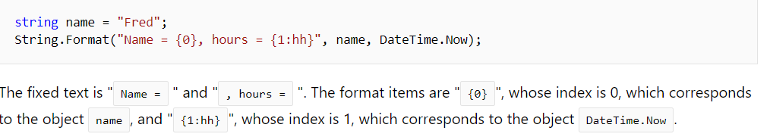
Composite Formatting
Format Item Syntax
Each format item takes the following form and consists of the following components:
{ index[,alignment][:formatString]}
The matching braces ("{" and "}") are required.
Example:

Slide 35
Format item - Index Component
The mandatory index component, also called a parameter specifier, is a number starting from 0 that identifies a corresponding item in the list of objects.
That is, the format item whose parameter specifier is 0 formats the first object in the list, the format item whose parameter specifier is 1 formats the second object in the list, and so on.
The following example includes four parameter specifiers, numbered zero through three, to represent prime numbers less than ten:

Slide 36
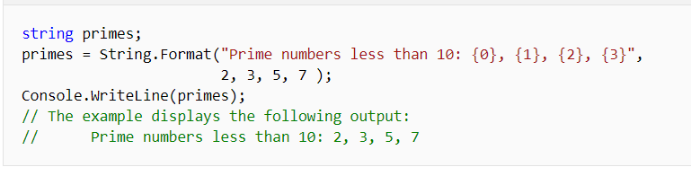
example

Slide 37
Format item -Alignment Component
The optional alignment component is a signed integer indicating the preferred formatted field width.
If the value of alignment is less than the length of the formatted string, alignment is ignored and the length of the formatted string is used as the field width.
The formatted data in the field is right-aligned if alignment is positive and left-aligned if alignment is negative.
The comma is required if alignment is specified.

Slide 38
Alignment Component
The following example(slide 39) defines two arrays, one containing the names of employees and the other containing the hours they worked over a two-week period.
The composite format string left-aligns the names in a 20-character field, and right-aligns their hours in a 5-character field.
Note that the "N1" standard format string is also used to format the hours with one fractional digit.

Slide 39
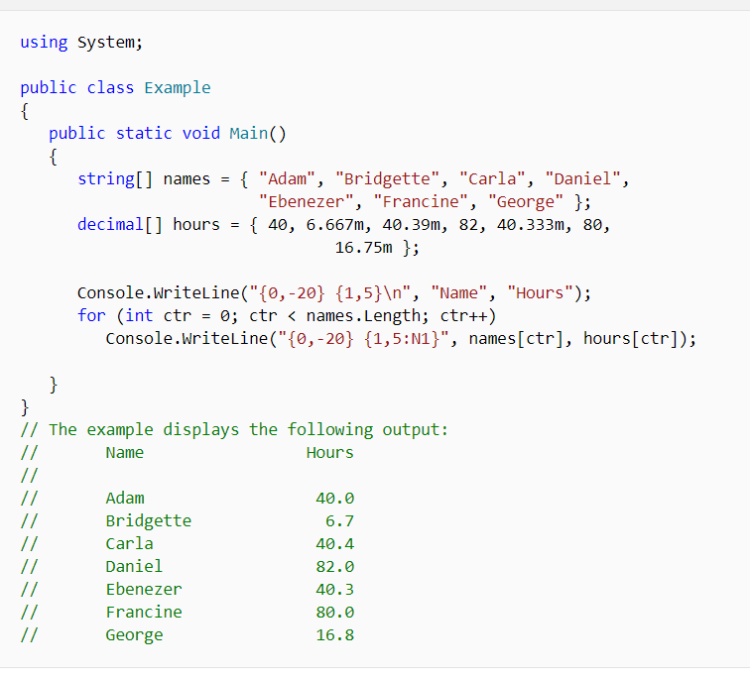

Slide 40
format item - Format String Component
The optional formatString component is a format string that is appropriate for the type of object being formatted.
Specify a standard or custom numeric format string if the corresponding object is a numeric value, a standard or custom date and time format string if the corresponding object is a DateTime object.
If formatString is not specified, the general ("G") format specifier for a numeric, date and time is used.
The colon is required if formatString is specified.

Slide 41
Numeric formatting codes

Slide 42
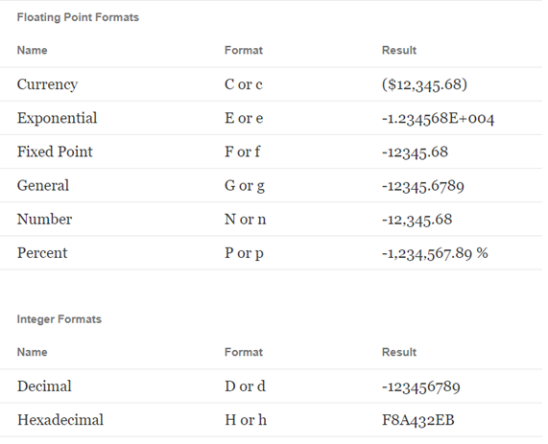
Examples - Numeric formatting

Slide 43
Some more examples of format method

Slide 44
Methods to convert numbers to formatted string
You can include a number after some of the numeric formatting codes to specify the number of decimal places in the result.
If the numeric value contains more decimal places than are specified, the result will be rounded using standard rounding.

Slide 45
Methods to convert numbers to formatted string
If you don't specify the number of decimal places, the default is 2.
You can include a number after the D or d formatting code to specify the minimum number of digits in the result. If the integer has fewer digits than are specified, zeros are added to the beginning of the integer.

Slide 47
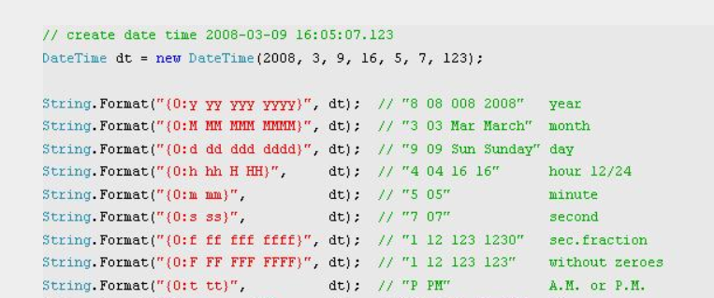
Datetime formatting codes

Slide 48
String interpolation

Slide 49
$ - string interpolation
An interpolated string is a string literal that might contain interpolated expressions.
When an interpolated string is resolved to a result string, items with interpolated expressions are replaced by the string representations of the expression results.
This feature is available in C# 6 and later versions of the language.

Slide 50

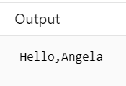
Example
The string argument of the WriteLine method call is an interpolated string. It's a kind of template that lets you construct a single string (called the result string) from a string that includes embedded code. Interpolated strings are particularly useful for inserting values into a string or concatenating (joining together) several strings.

Slide 51
String Interpolation
The example above contains the two elements that every interpolated string must have:
A string literal that begins with the $ character before its opening quotation mark character. There can't be any spaces between the $ symbol and the quotation mark character. (If you'd like to see what happens if you include one, insert a space after the $ character in the interactive window and run the updated code. The C# compiler complains, "Unexpected character '$'".)

Slide 52
String Interpolation
One or more interpolated expressions. An interpolated expression is indicated by an opening and closing brace ({ and }). You can put any C# expression that returns a value (including null) inside the braces.

Slide 53
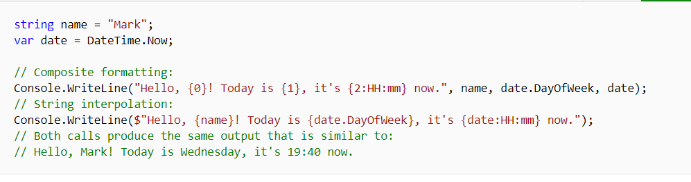
Example
Notes:
string name = "Mark";
var date = DateTime.Now;
// Composite formatting:
Console.WriteLine("Hello, {0}! Today is {1}, it's {2:HH:mm} now.", name, date.DayOfWeek, date);
// String interpolation:
Console.WriteLine($"Hello, {name}! Today is {date.DayOfWeek}, it's {date:HH:mm} now.");
// Both calls produce the same output that is similar to:
// Hello, Mark! Today is Wednesday, it's 19:40 now.

Slide 54
Nullable types

Slide 55
Working with nullable types
By default, value types (such as the int, decimal, and bool types) can't store null values.
In contrast, reference types (such as the string type) can store null values.
Most of the time, you won't need to use a value type to store null values. However, a feature of C# known as nullable types allows you to store a null value in a value type.

Slide 56
Working with nullable types
To declare a nullable type, you type a question mark (?) immediately after the type in the declaration of a value type.
Except for the question mark, this works just as it does for any other value type variable.

Slide 57
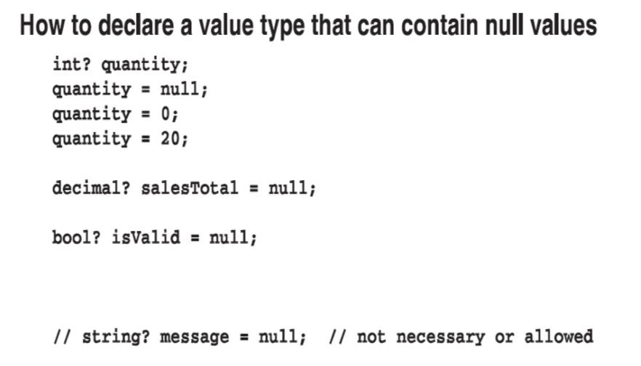
Working with nullable types

Slide 58
Working with nullable types
In the previous slide, for example, the first statement declares an int variable as a nullable type.
Then, the second statement uses the null keyword to assign a null value to this type. Typically, you use a null value to indicate that the value of the variable is unknown.

Slide 59
Working with nullable types
However, you can't declare a string type as a nullable type because the string type is a reference type and can store null values by default.
You can also use nullable types in arithmetic expressions. In that case, if the value of the nullable type is null, the result of the arithmetic expression is always null.

Slide 60
Working with nullable types

Slide 61
Working with nullable types
Once you declare a value type as nullable, you can use the HasValue property to check if the type stores a value or if it contains a null value.
Then, if it stores a value, you can use the Value property to get that value.

Slide 62
Working with nullable types
When working with value types, however, it's more common to assign a default value such as zero to indicate that the user didn't enter a value.
As a result, unless you're working with a database that returns null values, you probably won't need to use nullable types.

Slide 63
Working with nullable types

